Slide 1


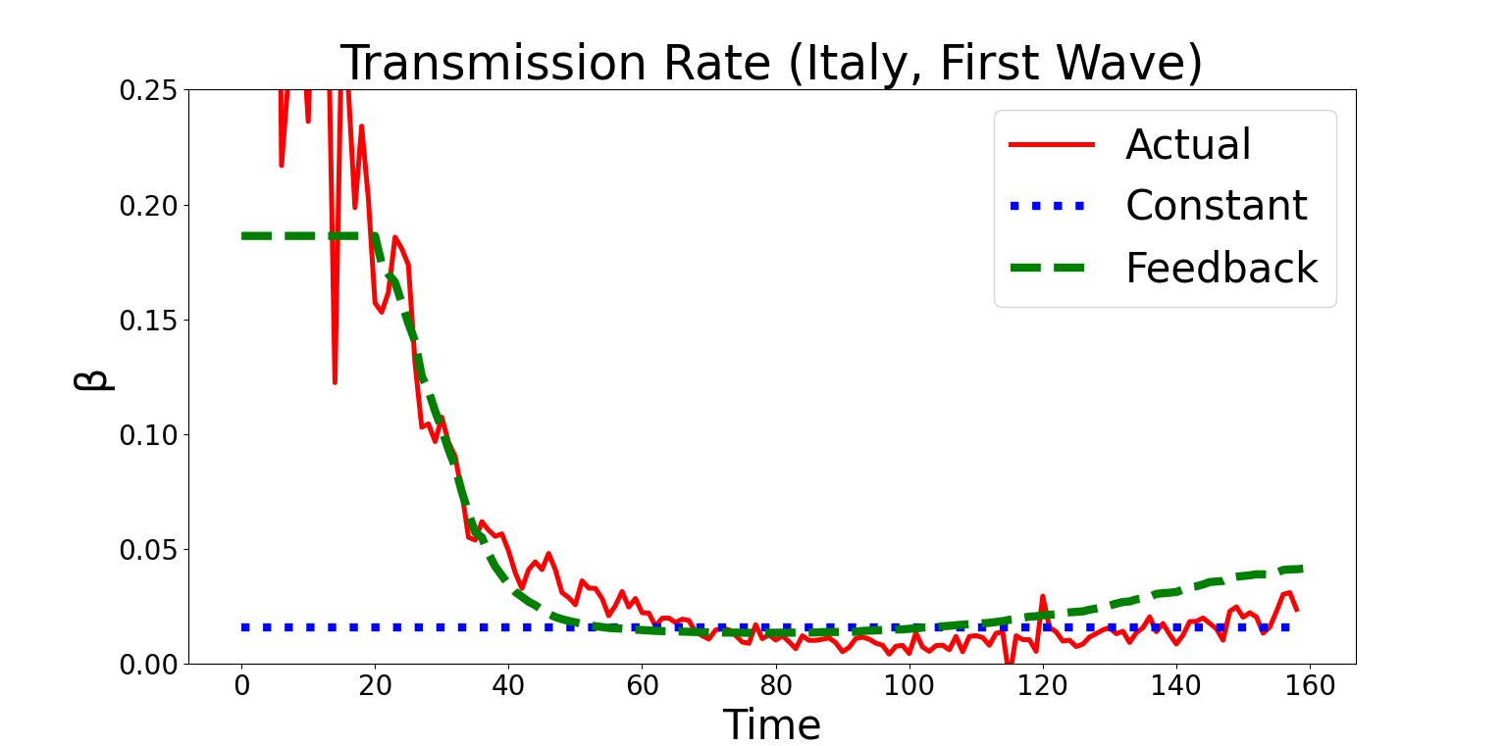
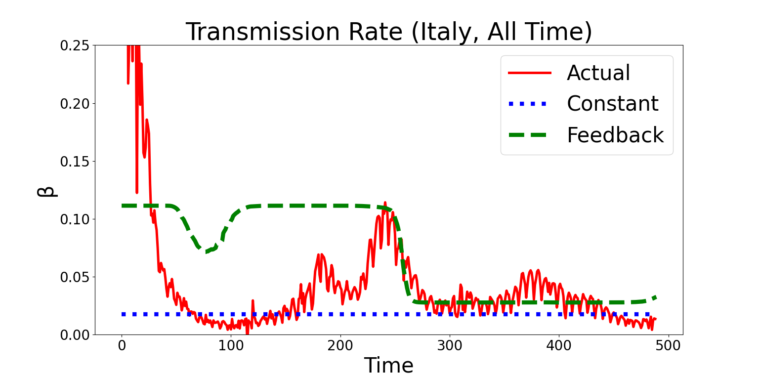
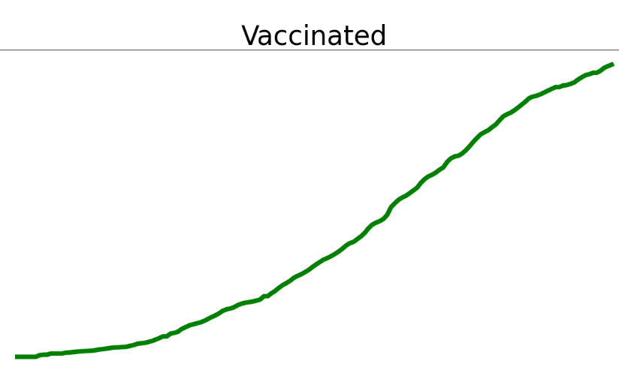
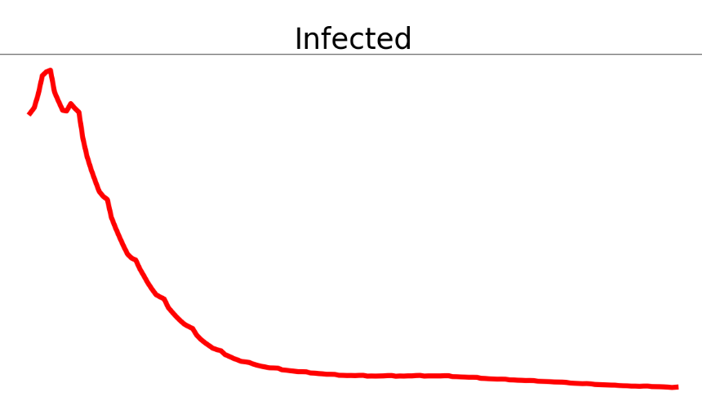
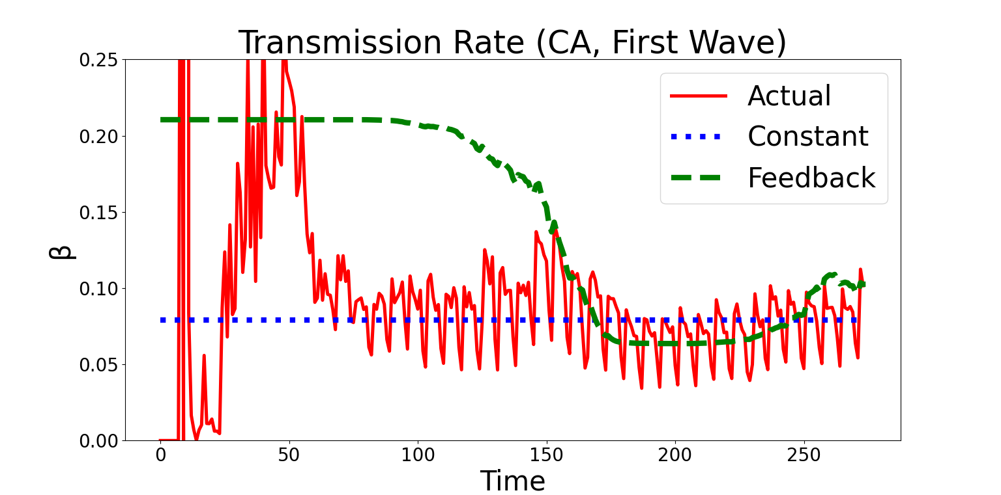
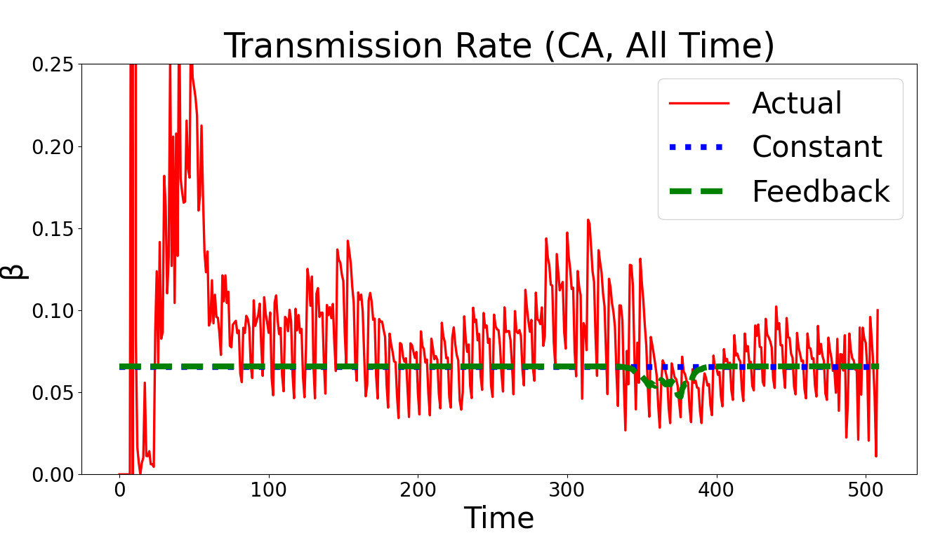
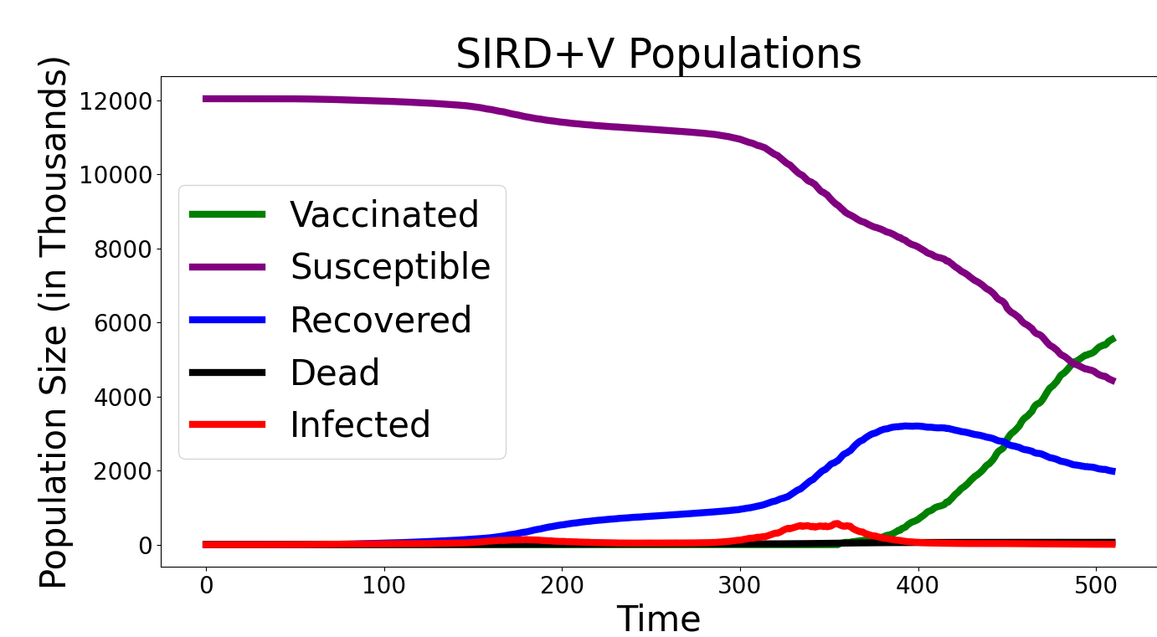
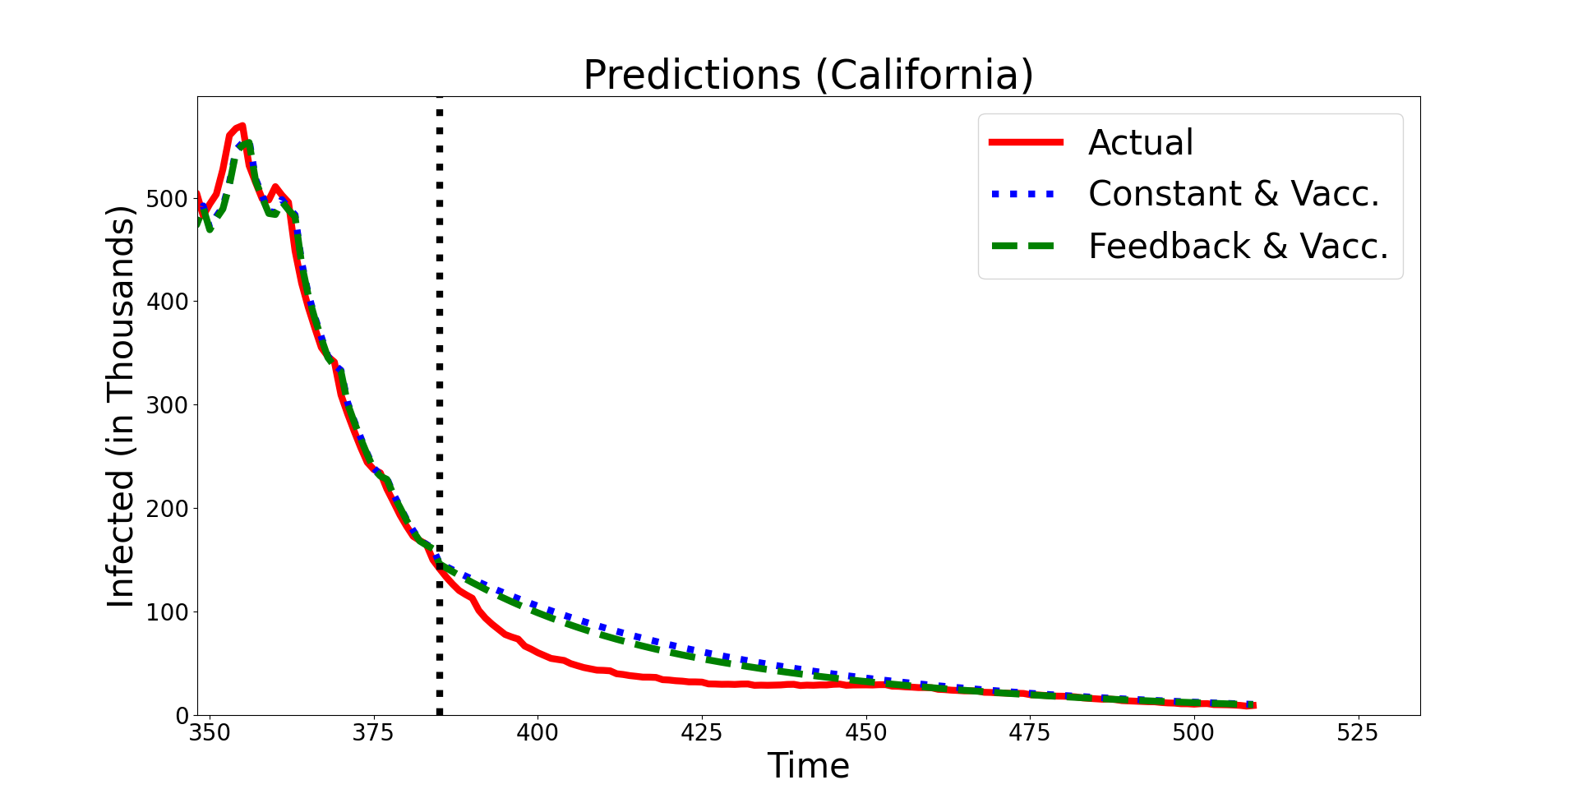
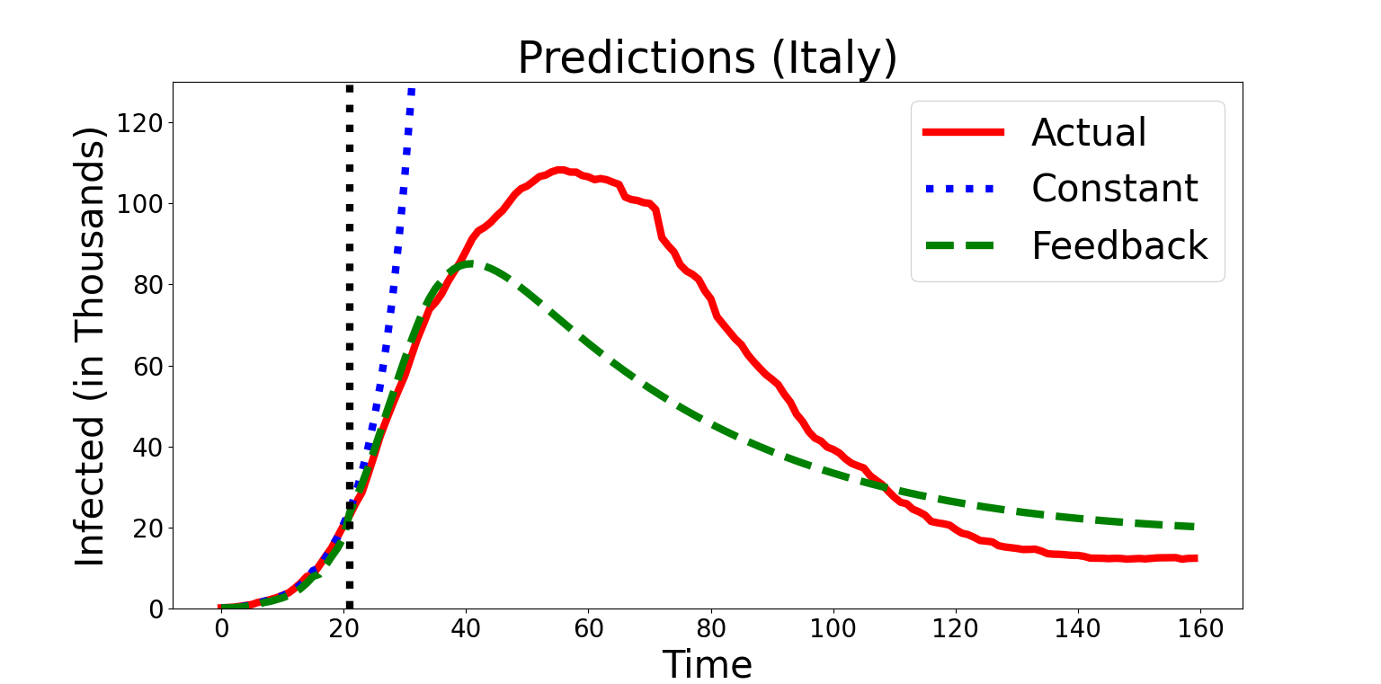
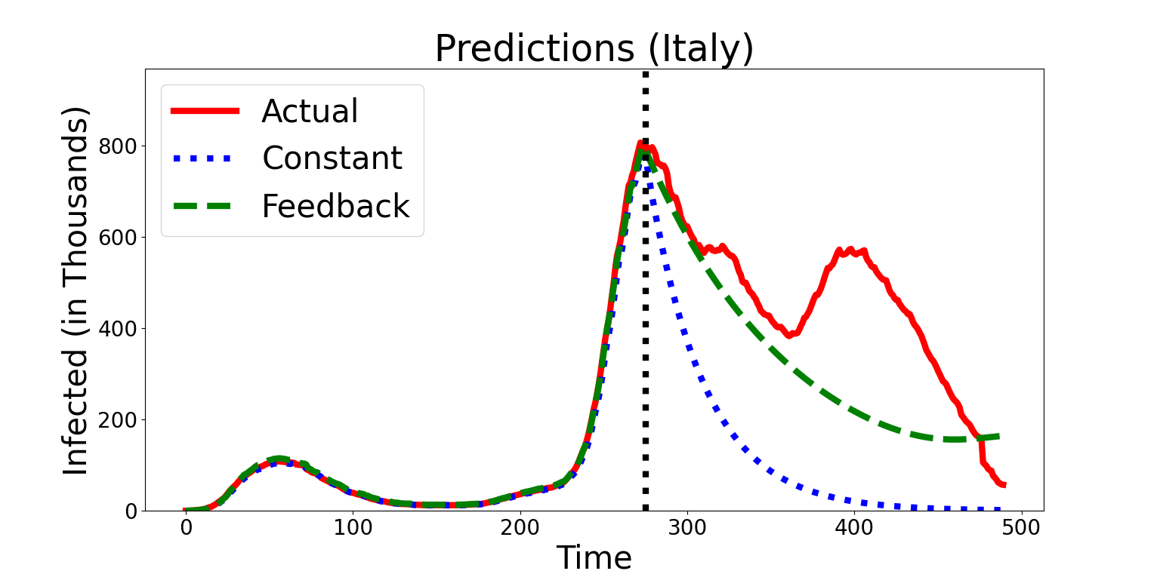
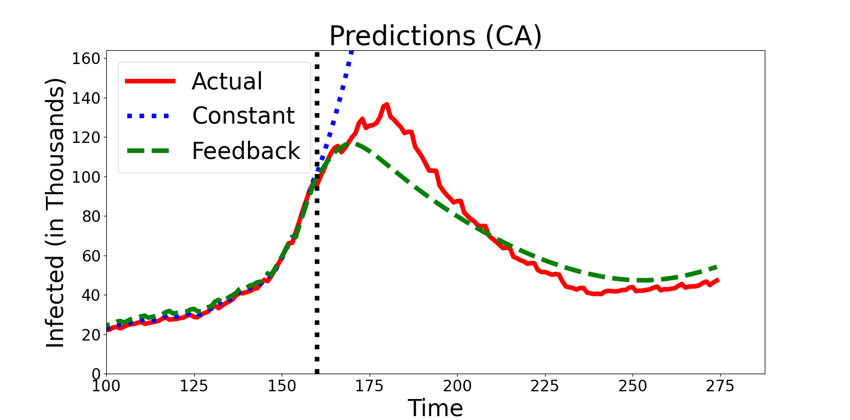
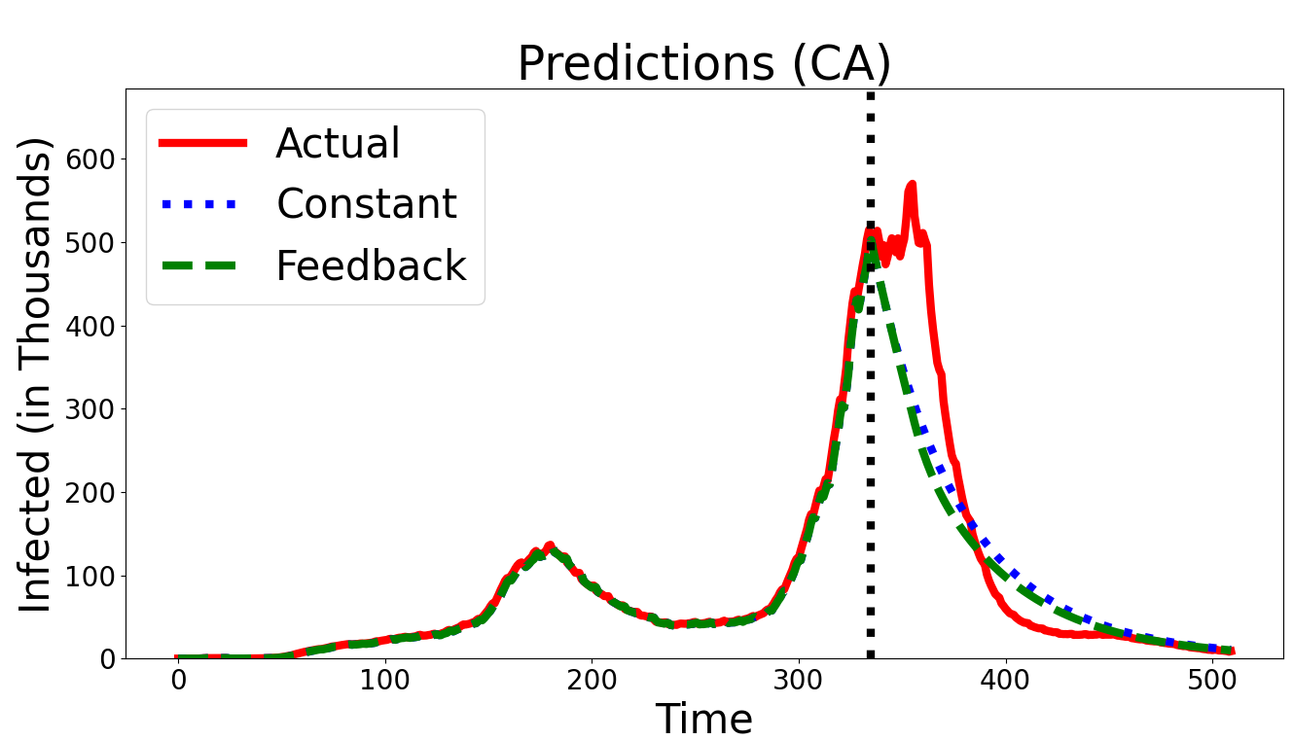
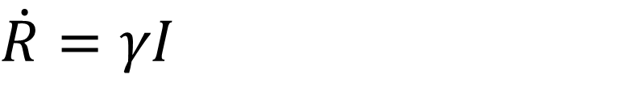
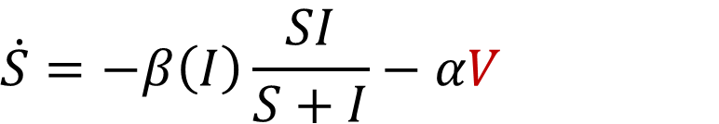
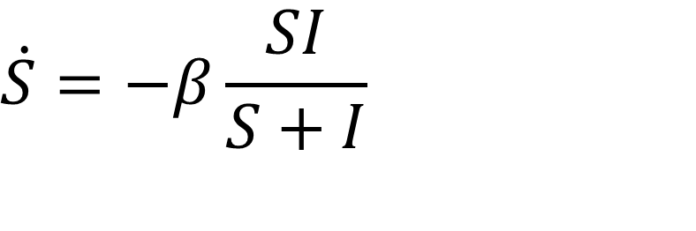
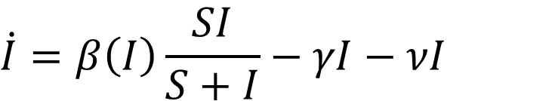
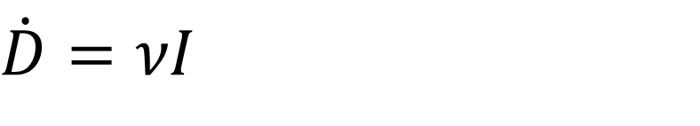
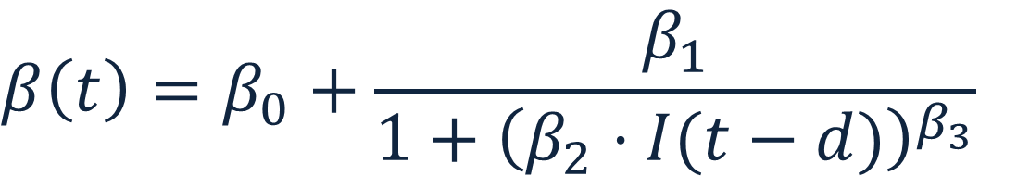
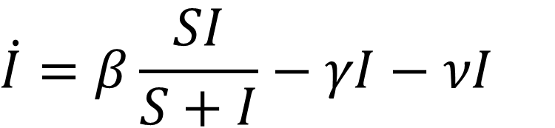
Tracking COVID-19 by Incorporating Feedback into the SIRD Model Daniel March¹, Jeston Bond¹, and Genti Buzi¹ ¹Department of Mathematics and Computer Science, Biola University ²Department of Kinesiology and Public Health, Biola University
Abstract
Results
Incorporating Vaccines
The COVID-19 global pandemic has highlighted the importance of identifying effective ways to control the spread of an infectious disease in a population. A solid understanding of the dynamics and the underlying mechanisms that govern this spread is an important step toward such a goal. Susceptible-Infected-Recovered (SIR) type models have played an important role in providing such insight. However, these models have limited explanatory and predictive power due to policy and behavior changes over time, usually in response to the intensity of the spread of the infection. Here we present a modified version of the standard SIR models by introducing feedback in the disease transmission rate. We apply this model to the publicly available COVID-19 US and international infection data. We show that this model is more robust to parameter variations due to public health interventions and has much better explanatory and predictive power.
Tracking the Transmission Rate
$$\begin{matrix}\dot{S}=−β\left(I\right)\frac{SI}{S+I}−αV\end{matrix}$$
V
$$\begin{matrix}\dot{I}=β\left(I\right)\frac{SI}{S+I}−γI−νI\end{matrix}$$
I
$$\begin{matrix}\dot{R}=γI−\left(1−α\right)V\end{matrix}$$
$$\begin{matrix}\dot{D}=νI\end{matrix}$$
Both the SIRD and SIRD feedback model can be adapted to incorporate vaccinations. To do this we assume both recovered and susceptible populations get vaccinated at the same rate.
Due to the low number of vaccinations when current infections were high, little difference is found in comparing the accuracy of the vaccinated with the standard models of SIRD and SIRD feedback. Only during times of high infections will the number of vaccinations significantly impact the number of newly infected individuals.
While high vaccinations may make a minor difference in times when the disease is decaying, high vaccinations are capable of curbing another wave of the infection, preventing further deaths.
Methods and Data
Data
The data for this project was extracted from publicly available databases. For US data, numbers for daily total infections, deaths, and vaccinations was acquired from the CDC [1]. For Italian data, numbers for current infections, recoveries, and death were acquired from the Italian Department of Civil Protection [2].
Additionally for some data sets the recovered population is not reported or unreliable. To approximate the recovered population, we assume infected individuals recover after 14 days.
Lastly, the susceptible population must be approximated. This is done by scaling the infected, recovered, and dead populations. This scaling factor, q, is solved using gridding and minimizing an objective function.
Model Predictions
Due to the transmission rate being constant in the SIRD model, any prediction can only show an unconstrained outbreak or decay of the disease. In predicting an unconstrained outbreak, the number of infections rises exponentially until there are no remaining susceptibles to infect.
Unlike the SIRD model, the feedback model is capable of predicting times of increasing and decreasing infections due to the allowance of the transmission rate changing over time. By assuming the local population has some delay in how it can react to new case data, either by naturally distancing or formal health guidelines being put into place, we find that the transmission rate can be modeled with a greater accuracy than the standard SIRD model. This allows for the feedback model to be accurate for a longer duration, while the standard SIRD model deviates rapidly after some period.
$$S\left(t\right)=q⋅Population −(I\left(t\right)+R(t)+D(t)$$
γ
R
Conclusions
SIRD Model
S
β
I
S(t) – population proportion that is susceptible
I(t) – population proportion that is infected
R(t) – population proportion that has recovered
D(t) – population proportion that has died
γ – the rate at which infected recover
ν – the rate at which infected die
ν
D
We have demonstrated that the SIRD feedback model has significant advantages of the SIRD model.
The feedback model is capable of predicting waves of infection, while the SIRD only predicts either a disease decay or an unconstrained outbreak spike.
The feedback model has a time varying beta which can track how the public and government react to the disease.
At worst, if the feedback model optimizes poorly, it has the same predictive power as the standard SIRD model.
$$\begin{matrix}\dot{S}=−β\frac{SI}{S+I}\end{matrix}$$
$$\begin{matrix}\dot{I}=β\frac{SI}{S+I}−γI−νI\end{matrix}$$
β – the transmission rate
(the rate at which infected infect susceptible)
$$\begin{matrix}\dot{R}=γI\end{matrix}$$
$$\begin{matrix}\dot{D}=νI\end{matrix}$$
This model has been applied successfully on the Italian dataset [3]. Our formulation of the model and results are consistent with their findings.
Feedback Model
References
The transmission rate is replaced by a time varying beta based on the number of current infections after some delay s (normally s=14). The nonlinear variables are solved by gridding and are positive.
γ
R
S
β
I
https://data.cdc.gov/Case-Surveillance/United-States-COVID-19-Cases-and-Deaths-by-State-o/9mfq-cb36
https://github.com/pcm-dpc/COVID-19
Giuseppe C. Calafiore, Carlo Novara, Corrado Possieri, A time-varying SIRD model for the COVID-19 contagion in Italy, Annual Reviews in Control, Volume 50, 361-372 (2020)
ν
D
$$\begin{matrix}β\left(t\right)=β_{0}+\frac{β_{1}}{1+{\left(β_{2}⋅I(t−d)\right)}^{β_{3}}}\end{matrix}$$

